Slide 1

EC-101 Basics of Electronics & Communication Engineering
Module-2
By
Dr. Priyank Saxena
Assistant Professor

Slide 2

Course Syllabus
Module-1 : Diodes and Applications Introduction to PN junction diodes; Characteristics of semiconductor diodes: V-I characteristics, diode-resistance, temperature- dependence, diode-capacitance; DC & AC load lines; Breakdown Mechanisms; Zener Diode — Operation and Applications; Diode as a Rectifier: Half Wave and Full Wave Rectifiers with and without C-Filters. {12 Lect. hours}
Module-2 : Bipolar Junction Transistor (BJT) Bipolar Junction Transistors (BJT): PNP and NPN Transistors, Basic Transistor Action, Input and Output Characteristics of CB, CE and CC Configurations, dc and ac load line analysis, operating point, Transistor biasing: Fixed bias, emitter bias/self-bias, Low-frequency response of CE amplifier. Field Effect Transistors: JFET, Idea of Channel Formation, Pinch-Off and saturation Voltage, Current-Voltage Output Characteristics; MOSFET: Basic structure, operation and characteristics. {12 Lect. hours}

Slide 3
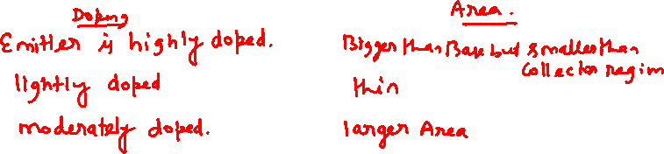
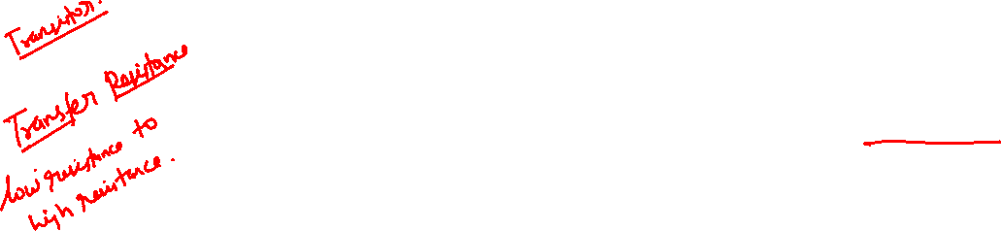
Bipolar Junction Transistor (BJT)
The bipolar junction transistor (BJT) has three separately doped regions and contains two p-n junctions.
Bipolar transistor is a 3-terminal device.
Emitter (E)
Base (B)
Collector (C)
The basic transistor principle is that the voltage between two terminals controls the current through the third terminal.
Current in the transistor is due to the flow of both electrons and holes, hence the name bipolar.

Slide 4
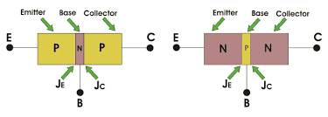

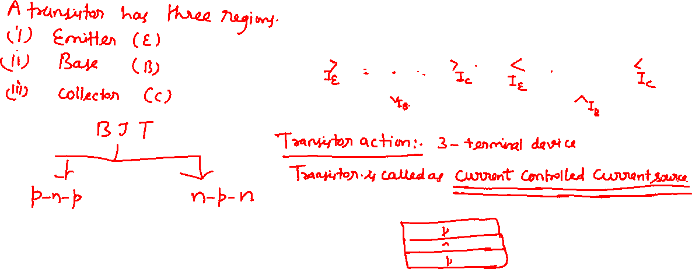
Bipolar Junction Transistor (BJT)

Slide 5
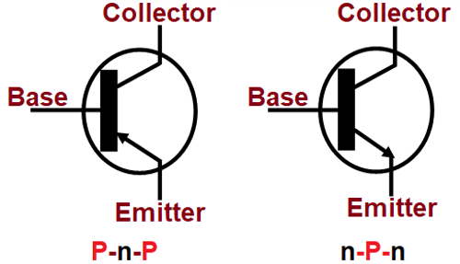
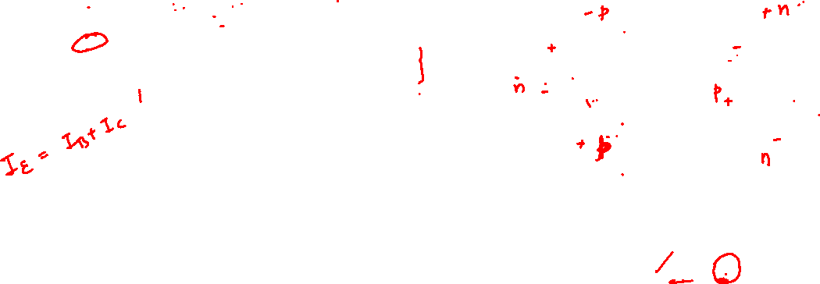

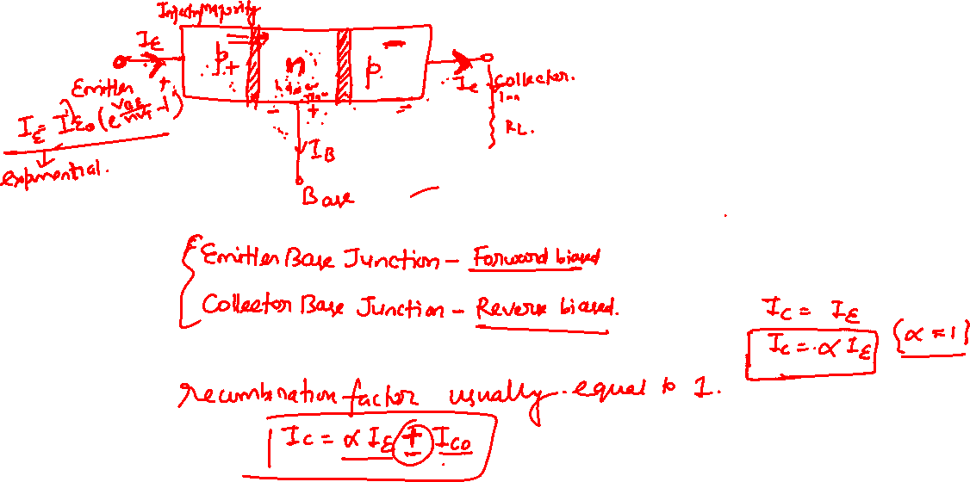
Bipolar Junction Transistor (BJT)

Slide 6
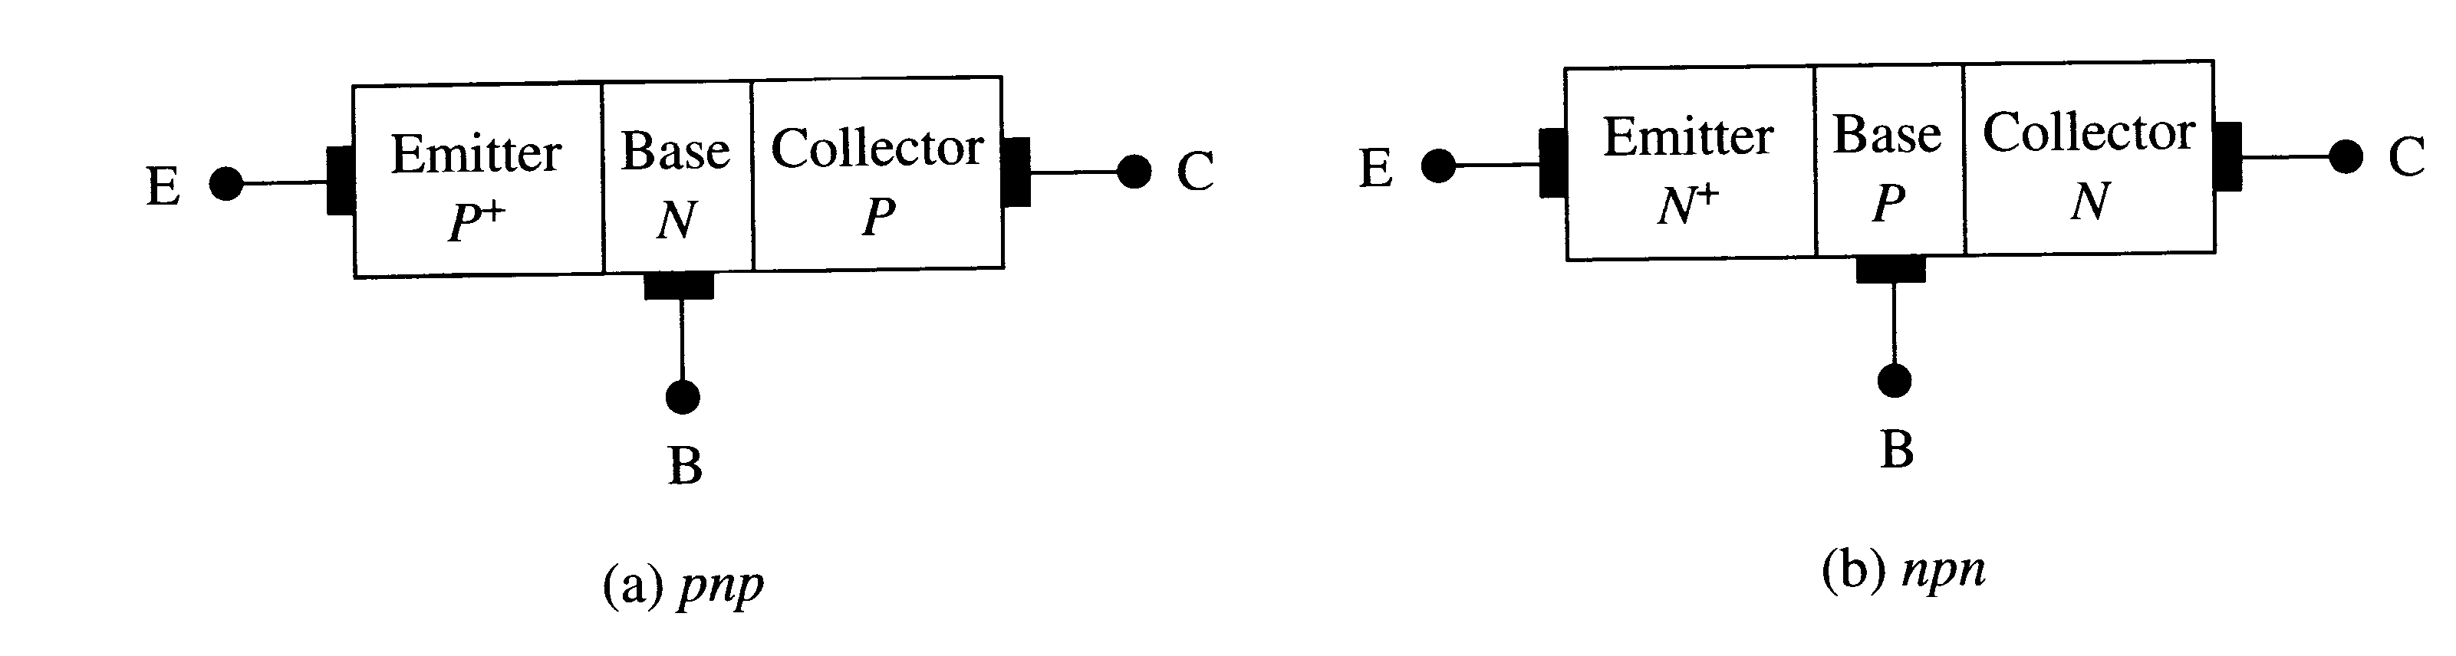

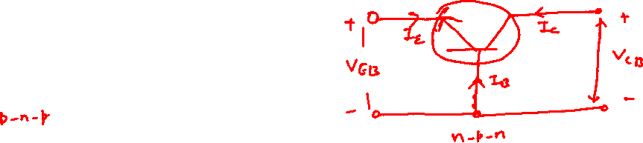
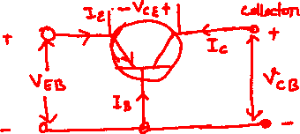
Bipolar Junction Transistor (BJT)
+
-
I_{E}
I_{C}
-
+
I_{B}
I_{E} = I_{B} + I_{C} ………(KCL)

Slide 7
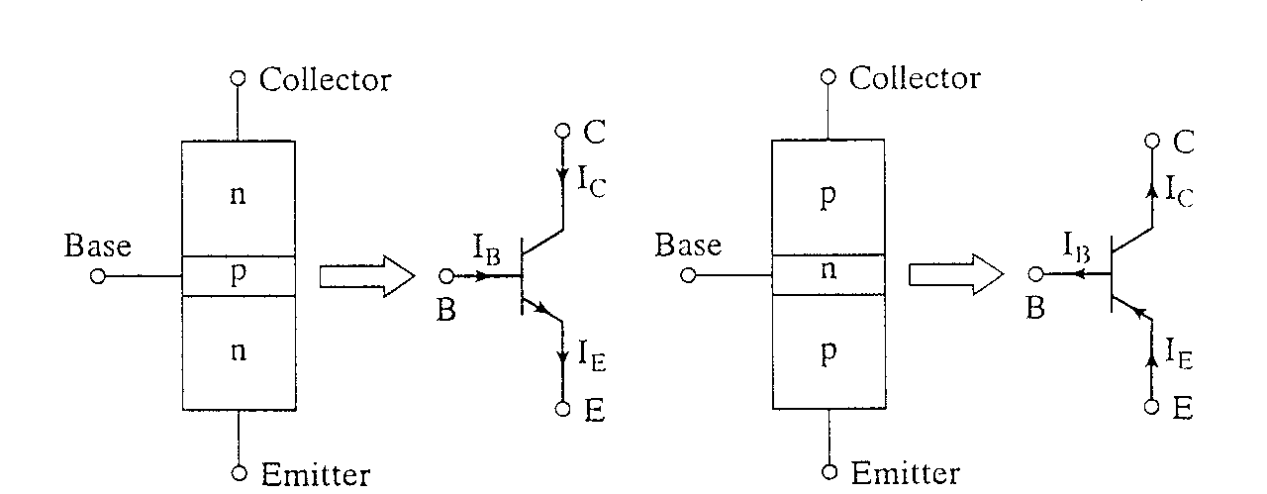
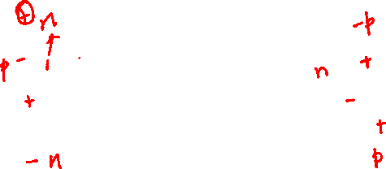
Bipolar Junction Transistor (BJT)
NPN
PNP

Slide 8


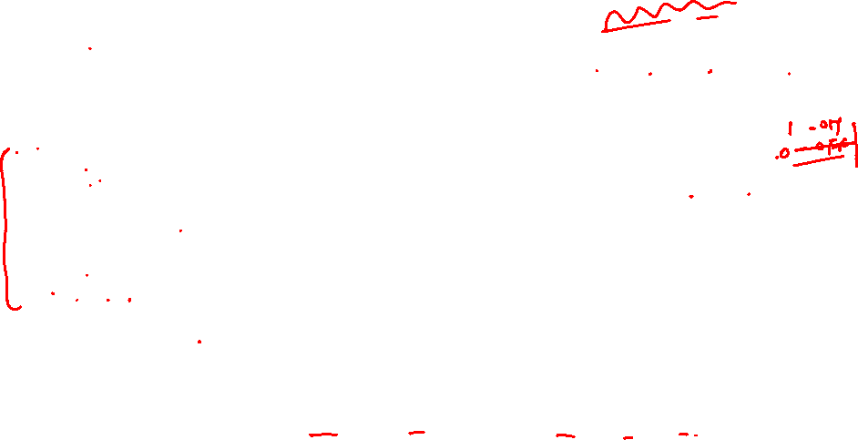
Different operating Conditions for a BJT
Active
Operating range of the amplifier. Base-Emitter Junction forward biased. Collector-Base Junction reverse biased
Cutoff
The amplifier is basically off. There is voltage but little current. Both junctions reverse biased
Saturation
The amplifier is full on. There is little voltage but lots of current. Both junctions forward biased.
Inverse Active
Base-Emitter Junction reverse biased. Collector-Base Junction forward biased

Slide 9
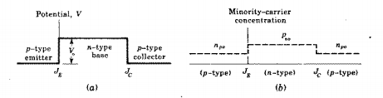


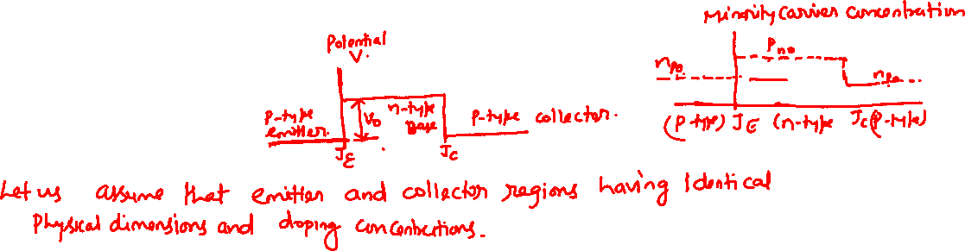
Open Circuited Transistor (BJT)

Slide 10
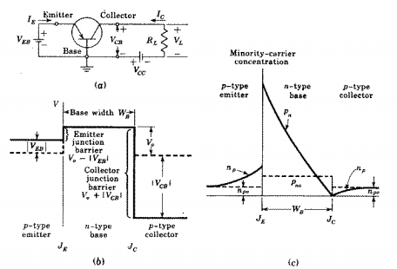

P-N-P Transistor Biased in Active Region

Slide 11
E
B
C
I_{E}
p⁺
n
p
I_{C}
holes
e⁻ gain, reverse bias
I_{B}
holes
I_{E}
I_{C}
I_{CB0}
I’_{B}
I”_{B}
Recombination
e⁻ loss
e⁻ loss, forward bias
I_{B} = I’_{B} + I”_{B} – I_{CB0}
I_{B}

Slide 12
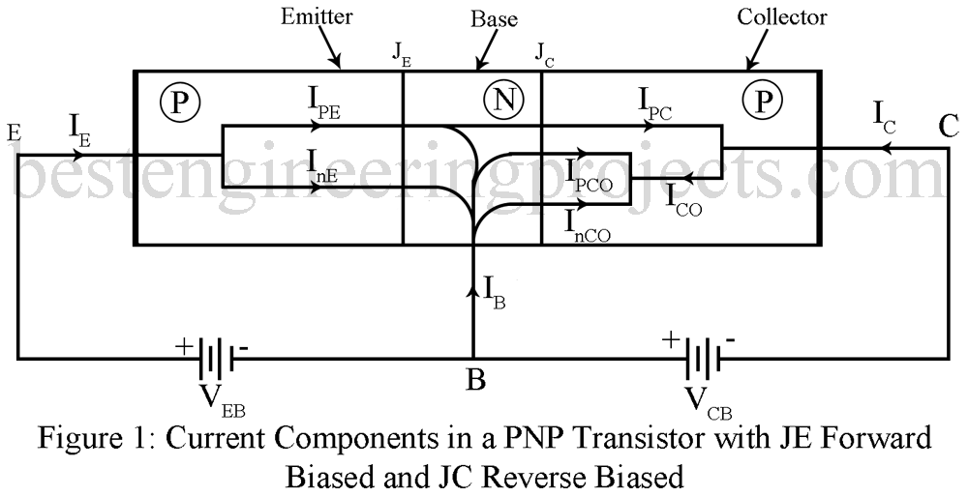

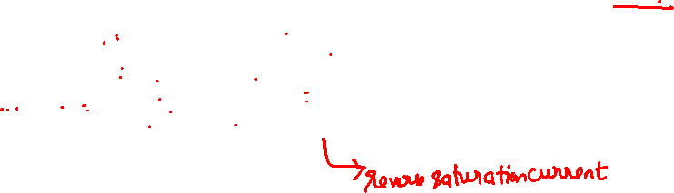
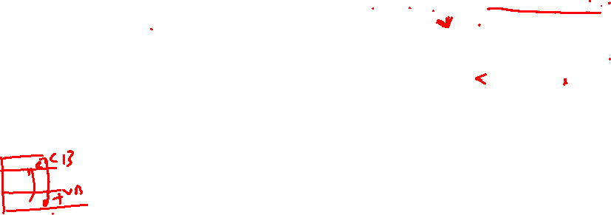

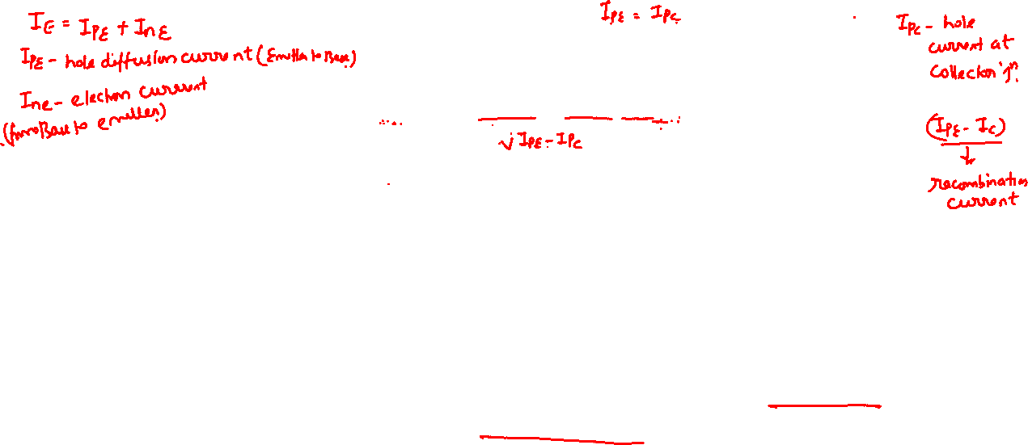
Bipolar Junction Transistor (BJT)

